Slide 1
Unraveling the Challenges of Unemployment in Africa: A Data-Driven Approach
Kwame Otchere
Notes:
ID=d924773e-9a16-4d6d-9803-8cb819e99682 Recipe=text_billboard Type=TextOnly Variant=0 FamilyID=AccentBoxWalbaum_Zero

Slide 2

Sections
Introduction
Framework
Analysis Approach
The Dataset
Analyses
Summary of Insights
Recommendations
Limitation
Conclusion

Slide 3
Introduction
The objective of this project is to leverage data to propose informed recommendations to help stakeholders effectively address unemployment in Africa
Africa has been one of the top 2 continents with the highest median unemployment rates since 2010. This is opposite Asia and Oceania who have been bottom 2 over the same period.
Thought for the day: Is unemployment in Africa a problem of skills or a problem of opportunities?

Slide 4
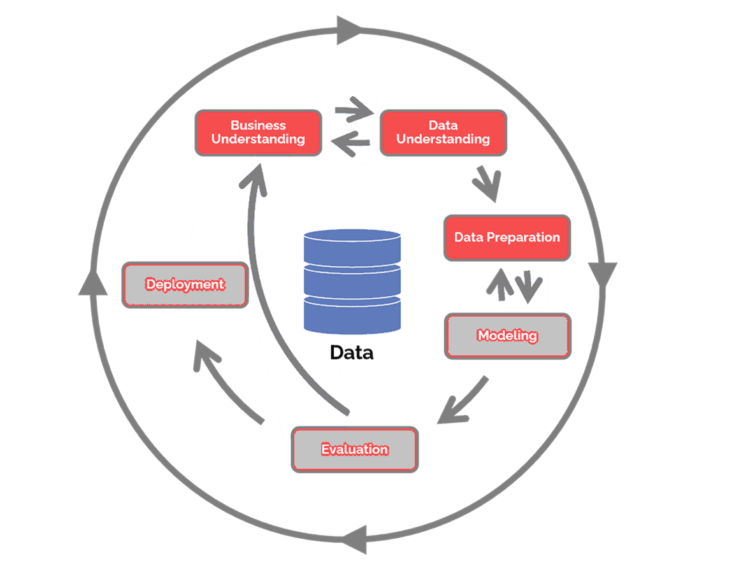
Framework: CRISP-DM

Slide 5
Analysis Approach
Objective
Data Preparation
Data Analysis
Recommendations
Insight Generation

Slide 6
Dataset: Overview
Divided into 6 documents:
Unemployment Rate (Men vs. Women)
National Strategy for Youth Employment
Share of Education in Government Expenditure
Population with Access to Electricity
Total Firms (Historical Data)
Country Codes
Key columns:
Country Name
Country Code
Unemployment Rates by Gender
Population Estimate
Youth Employment Strategy
Spending on Education
Electricity Access
Business Density Rate
Time span: 2006 – 2020
Analysis coverage: 2010 - 2020

Slide 7
Dataset: Initial Observations for Africa
Unemployment rates for African countries range from 0.99% - 30.72%, with the mean and median standing at 10.32% and 8.34% respectively.
The percentage of the populations with access to electricity also ranged from 9.7% - 100%, with the mean and median standing at 60.21% and 54.02% respectively. It had a standard deviation of 21.82.
Businesses per thousand people (of working age) ranged from 0.10 - 175.13 in African countries. The average and median stood at 20.62 and 10.09 respectively.
Total business density rate stood between 0.10 and 28.13, hence countries with values beyond this are also regarded as outliers in this regard. Botswana and Mauritius were the highest in this regard.
Spending on education as a percentage of government expenditure ranged from 4.65% - 32.73%. The average and median stood at 16.24% and 16.06% respectively. The standard deviation of 5.367 may imply that differences in this may not vary much across observations in the dataset. Sierra Leone and Zimbabwe were outliers in this regard, exceeding 30%.
Population estimate: The upper fence of population estimates in Africa is about 58.09m. Hence countries with populations exceeding this value were identified as outliers.

Slide 8
Analyses

Slide 9
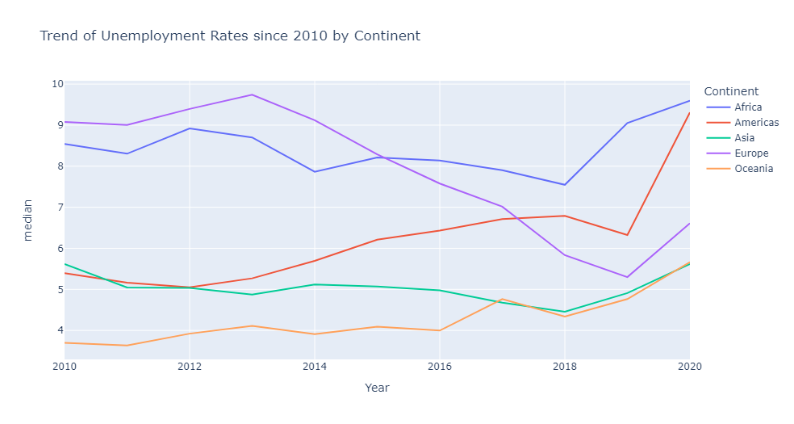
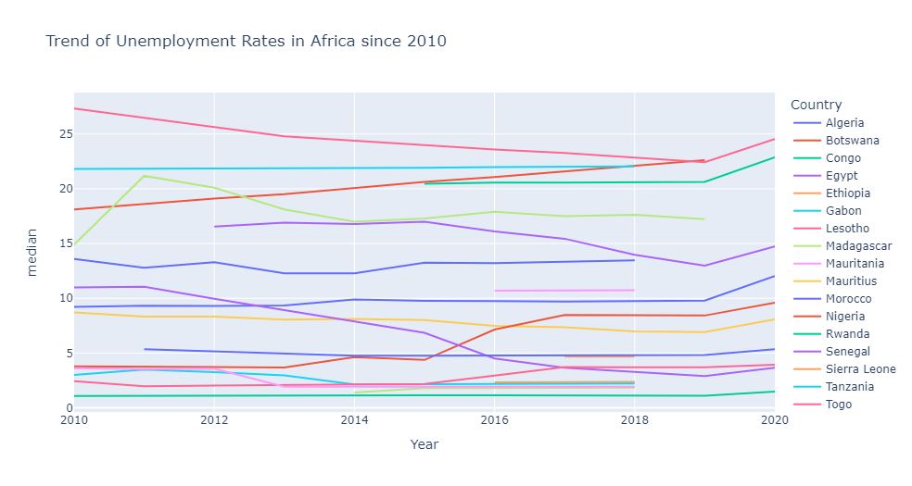
How do unemployment rates look like?
Africa has been one of the top 2 continents with the highest median unemployment rates since 2010. Oceania and Asia, on the other hand, have maintained their placements as the 2 continents with the lowest unemployment levels.
Europe will be our benchmark for medium to long term improvement since they have done it before
Rwanda, Madagascar, Uganda, Tanzania and Ethiopia have the lowest rates of unemployment across the continent
Lesotho, Gabon, Botswana, Congo, and Tunisia have the highest unemployment rates in Africa.

Slide 10
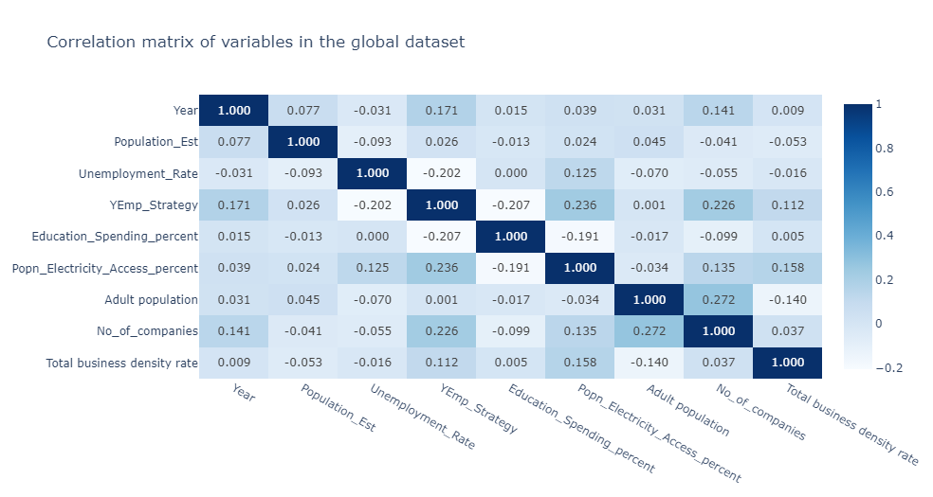
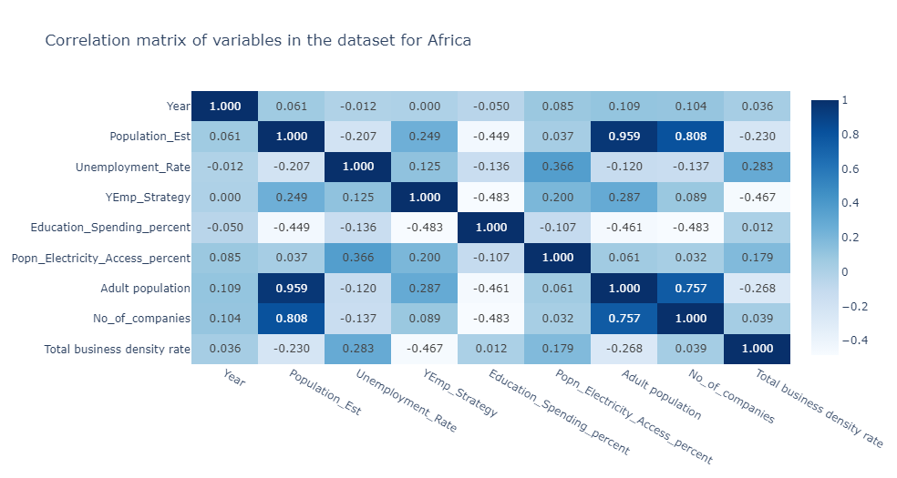
Correlations between variables
Variables in the dataset have weak correlations with Unemployment Rates. Africa is not far from this “norm”.
The most correlated variables of unemployment across board are youth employment strategy and electricity access.
For Africa, total business density rate (0.283), population estimates (-0.207), and spending on education (-0.136) add to the above for the top 5

Slide 11
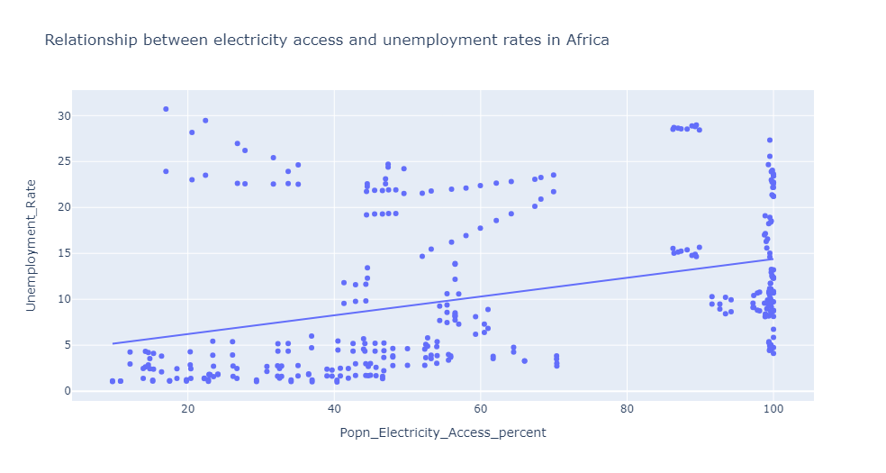
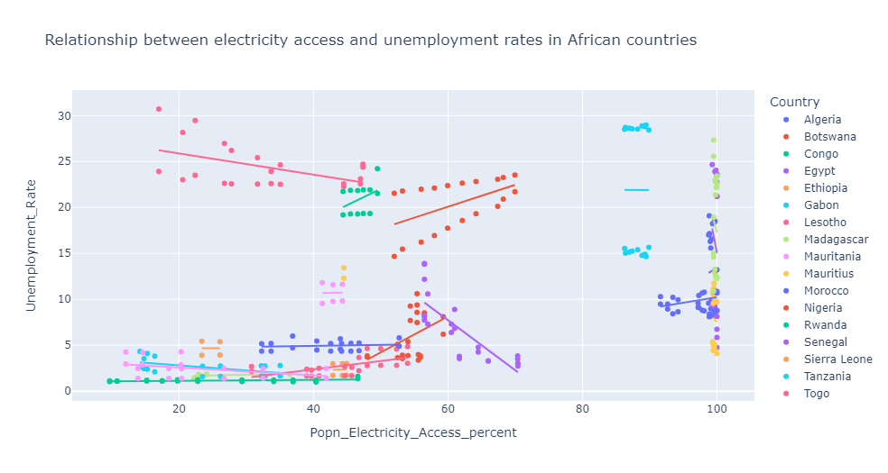
Hypothesis: Countries with higher electricity access rates have lower unemployment rates
Generally, unemployment rates increase with increases in the percentage of the population that has access to electricity as seen in the chart and their correlation 0.37. An R2 of 0.13 leaves room for further analysis, as such we reject the hypothesis for now
The coloured plot reveals differences in the interaction between the variables. While countries like Egypt, Mauritius, Senegal, and Tunisia get decreases in unemployment rates with increases in access to electricity, the opposite holds for countries like Botswana, Nigeria, Morocco, and Congo whose unemployment rates increase despite increases in access to electricity in their population.

Slide 12
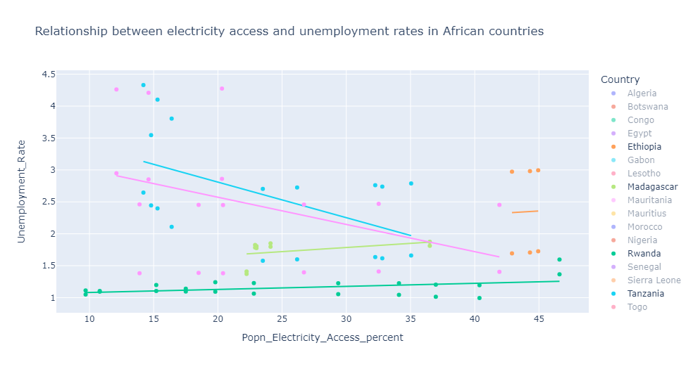
For the African countries with the lowest rates of unemployment, we notice that unemployment rates generally decrease with significant increases in electricity access to the population.
Other countries may want to increase investments in boosting electricity access to reap the (in)direct benefits on unemployment rates

Slide 13
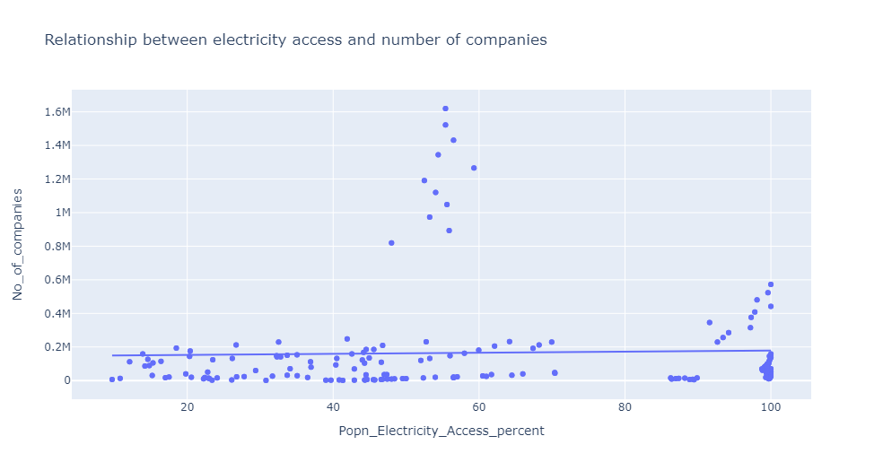
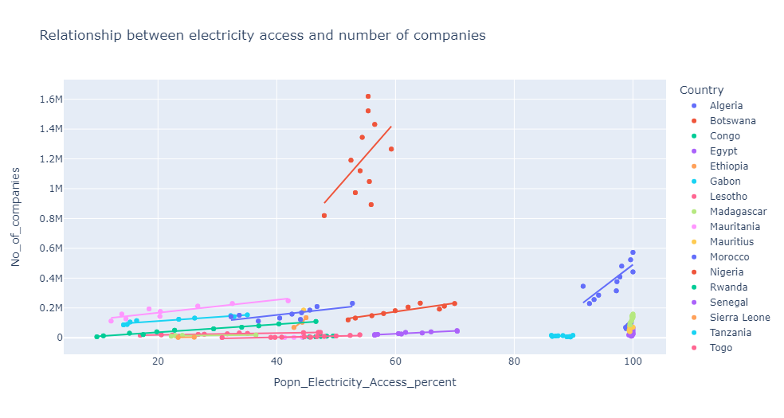
What effect does electricity access have on number of companies?
Despite the weak correlation between electricity access and number of companies (0.179), the effects incremental effects of electricity access are felt more in some countries like Nigeria, Morocco, and Tunisia than in others. There were no notable negative trends for any country.

Slide 14
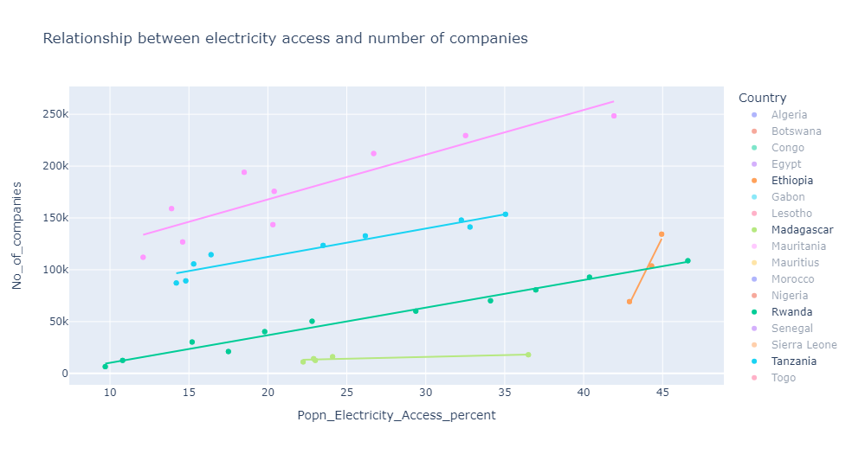
The countries with lowest rates of unemployment buttress the earlier point that increases in electricity access to the population leads to increases in the number of companies in a country.
Countries may therefore want to make themselves more attractive for business by increasing electricity access to the populace, at least beyond the 35% mark

Slide 15
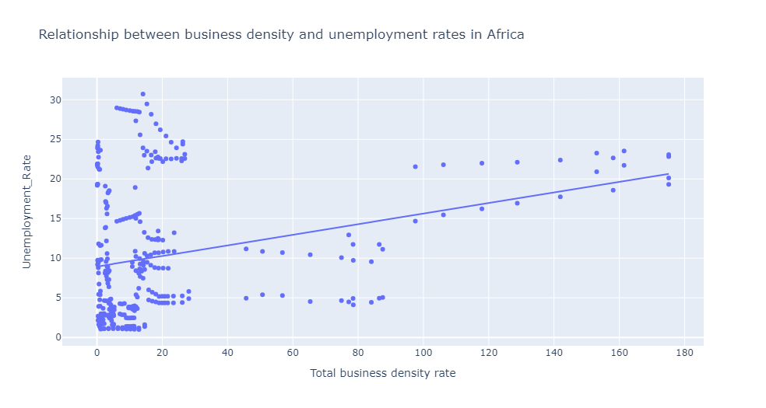
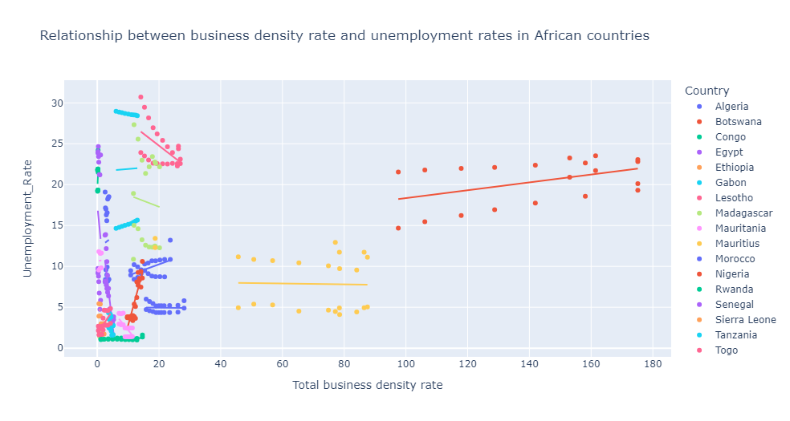
Hypothesis: Countries with higher business density rates have lower unemployment rates
Unemployment rates increase with business density rates
This is true for countries like Botswana, Nigeria and Morocco. However, it does not hold for Lesotho, Senegal and Egypt
Reject the hypothesis, since both the correlation (0.283) and the visualization imply a positive relationship between them

Slide 16
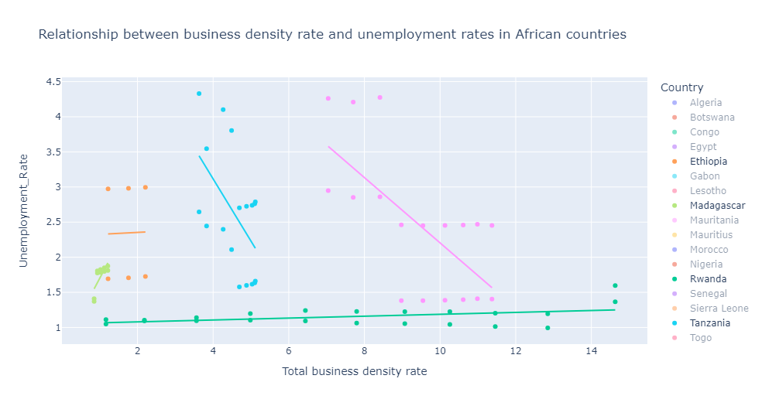
Except for Rwanda and Ethiopia whose lines seem flat, total business rates have generally led to a reduction in unemployment rates, hence other countries should try to emulate same by creating environments that increase the number of businesses per thousand*

Slide 17
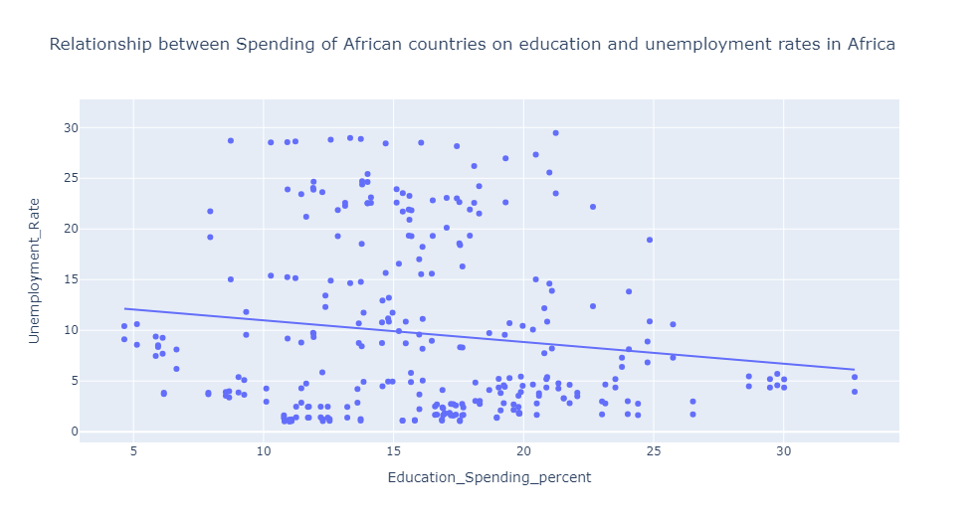
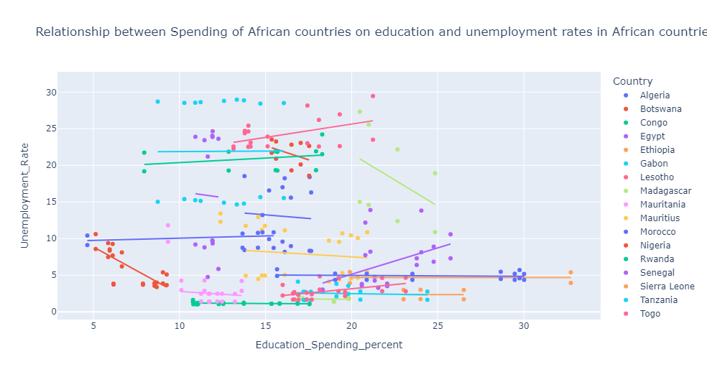
What is the relationship between unemployment rates and investment in education?
The correlation between unemployment rates and spending on education (-0.136) is supported by the regression plot (R2 = 0.019)
A fair number of countries follow the earlier observation, with the steepest being Nigeria (R2 = 0.595) and Tunisia (R2 = 0.179)
Notable contradictions are Lesotho (R2 = 0.228), Senegal (R2 = 0.189) and Congo (R2 = 0.079) whose rates increase regardless

Slide 18
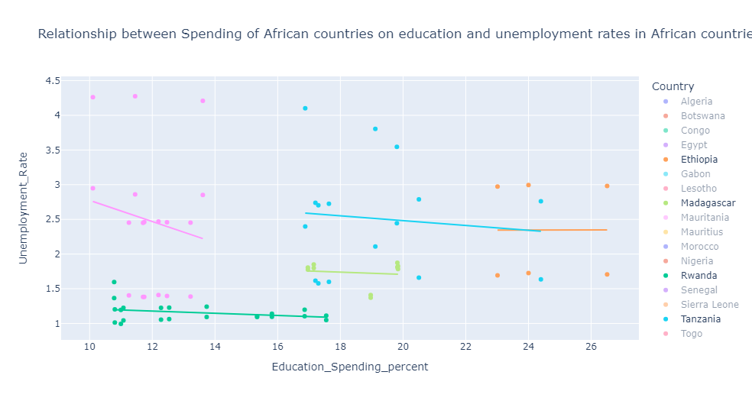
The African countries with lowest rates of unemployment have seen the rates decrease with increases in spending on education. Other countries may want to up investments in education as well

Slide 19
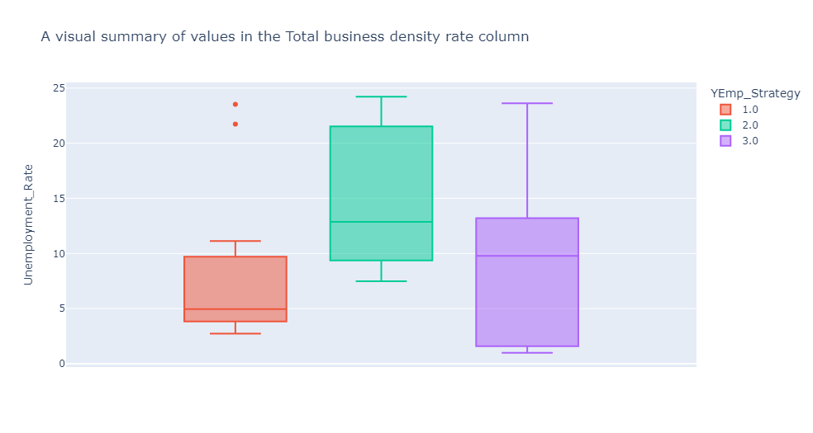
How does strategy influence unemployment rates?
Countries who are now developing youth employment strategies have low unemployment rates (usually between 2.74% and 11.13%, and ). Countries who have adopted but not operationalized their strategies have the highest rates of unemployment (7.27% and 24.21%). Countries who have operationalized their strategies have lower
All countries should strive to operationalize employment strategies right after development

Slide 20
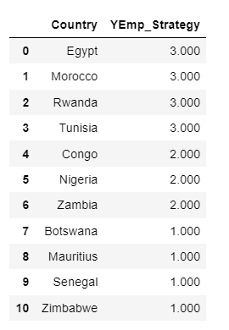
But how many countries have a strategy?
There are only 11 countries with a national strategy for youth employment
4 have been operationalized,
3 have adopted but are yet to operationalize,
the other 4 are now developing
Given the influence of youth employment strategy on unemployment rates, countries should strive to operationalize employment strategies right after development

Slide 21
Summary of Insights
Key determinants of unemployment rates in Africa are
Access to electricity: higher access reduces unemployment rates in benchmarks
Business density rate
National Strategy on Youth employment
Spending on education : higher spending reduces unemployment rates in benchmarks
Rwanda, Madagascar, Uganda, Tanzania and Ethiopia have the lowest rates of unemployment across the continent. They can be used as short-medium term benchmarks
Countries who are now developing youth employment strategies and countries who have operationalized theirs have the lowest unemployment rates.

Slide 22
Recommendations
In the short term, countries need to analyze more data on other possibly influential factors like general education levels, inflation and other economic factors.
The AU and countries must define and commit to a strategy to tackle unemployment.
Countries should operationalize the strategies right after development and set SMART goals to that end. Implementation should be monitored and evaluated.
Countries should aim to increase electricity access beyond 35% to reap the (in)direct benefits on unemployment rates in line with the strategies.
Countries should increase expenditure on education holistically (access, equity, and curriculum relevance).
Countries should actively stimulate the creation, survival, and growth of businesses to increase business density rates. Key considerations include financing, regulations and general ease of doing business.

Slide 23
Limitations
No data on actual values of expenditure on education
Lack of data on education levels
Inadequate data on youth employment strategies over the period
Comprehensive data covers just about 21 countries. Analysis may not be representative
No data on general economic metrics such as cost of living, inflation, GDP, and interest rates

Slide 24
Next Steps
Collect more data to “complete” the current dataset
Source data on other potentially influential economic factors
Experiment with cluster analysis using key variables
Perform diagnostic analysis
Experiment with predictive modelling

Slide 25
Conclusion
Unemployment rates are a result of interactions between several different factors.
Both skills and opportunities affect unemployment rates in Africa.
Deliberate efforts involving youth employment strategy operationalization and increased spending on education & access to electricity are good first steps to address the challenges of unemployment in Africa.

Slide 26
References
The fight against unemployment - European Parliament (link)
Unemployment and the European Union, 2000–2017: structural exploration of distant past economic experience and future prosperity (link)

Slide 27

Thank You
Kwame Otchere
kodoi270@gmail.com

